Slide 1
Pelham Library Guild
Information Meeting

Slide 2
Purpose of the Library Guild
To advocate for the library
To increase community awareness and use of the library
To volunteer at library events
To provide the library with suggestions and ideas for programming
To raise money and support for a new library building

Slide 3
Rendering of the NEW Pelham Public Library

Slide 4
What does membership in the Guild entail?
Yearly membership fee of $10 per member (Membership fees are tax deductible and will be applied to the Building Fund)
A commitment to volunteer at least twice at a Guild or Library event.
OR
Serve as an active member on a Guild committee.

Slide 5
Volunteer opportunities:
Taste of Pelham
Tuesday, March 7, 2017
Help with set up
Put out signs
Sell tickets
Work the ticket booth
Staff the Guild booth

Slide 6
Other opportunities:
Help at a Library or Guild event
Help with set up or break down of a book sale
Volunteer at the library by cleaning DVDs, marking out books for the book sale, or tidying shelves
Staff a Guild booth at a community event

Slide 7
Committees:
Taste of Pelham
5 member committee to assist Debbie with planning and implementing The Taste of Pelham.
Fundraising Committee
Committee to plan fundraisers for the Building Fund, as well as solicit donations from area businesses and community members.

Slide 8
Benefits of membership:
Being a fundamental part of an historic moment in Pelham’s growth: the building of a new library
Monthly emails on the progress of the building project and any Library or Guild events taking place
First opportunity to see the new library before the general public
Input into some of the features of the new library

Slide 9
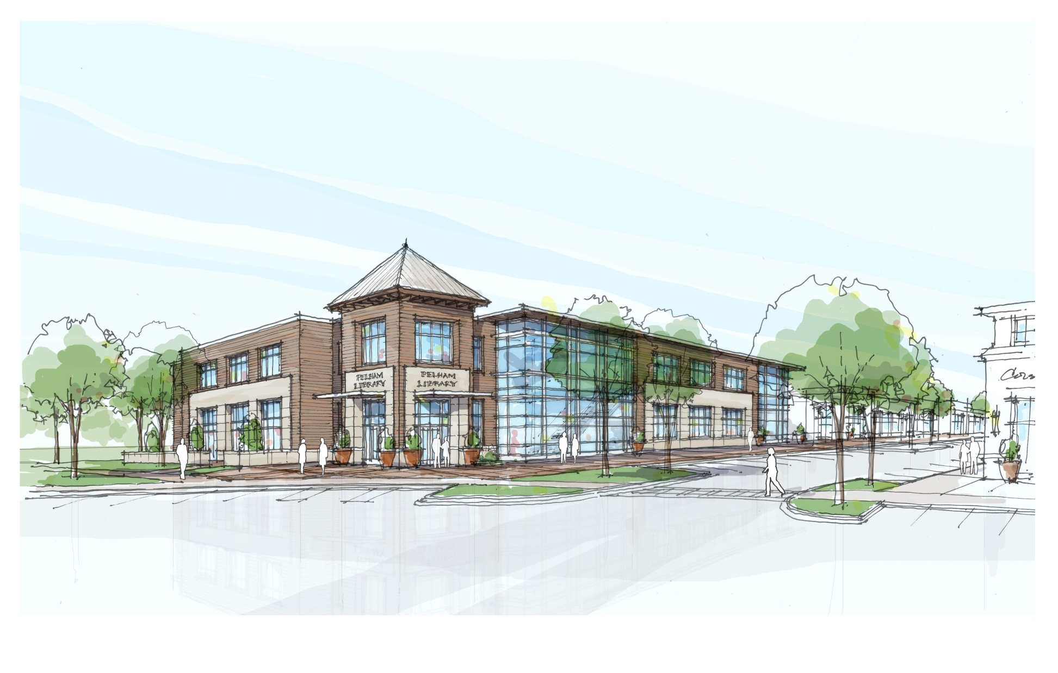
Building a brighter future

